Slide 1

GITHUB
DARSHINI S

Slide 2
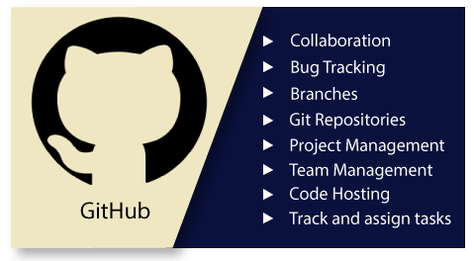
What is Git
Git is a free and open source distributed version control system.
It’s a system that records changes to our files every time.
Designed to handle everything from small to very large projects with speed and efficiency.
Many people can easily collaborate on a project and have their own version of project files on their computer.

Slide 3
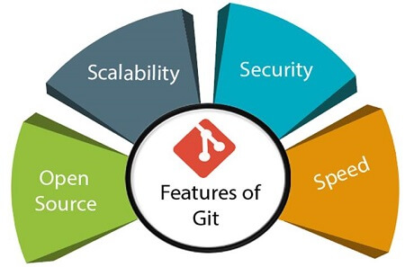
Features of Git
open source : Git is an open-source tool. It is released under the GPL (General Public License) license.
Scalability : Git is scalable, which means when the number of users increases, the Git can easily handle such situations.
Distributed : One of Git's great features is that it is distributed. Distributed means that instead of switching the project to another machine, we can create a "clone" of the entire repository.
Security : Git is secure. It uses the SHA1 (Secure Hash Function) to name and identify objects within its repository.
Speed : Git is very fast, so it can complete all the tasks in a while.

Slide 4
Github
Online service that hosts our projects.
Share our code with other developers.
Developers can download the projects and work on them.
They can re-upload their edits and merge them with the main codebase.

Slide 5
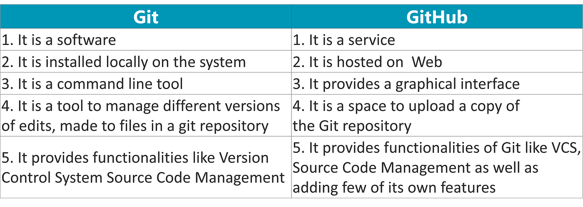
Difference Between Git and Github

Slide 6
Git Version Control System
A version control system is a software that tracks changes to a file or set of files over time.
It allows us to work together with other programmers.
Developers can compare earlier versions of the code with an older version to fix the mistakes.
Some of the benefits to use the version controlling systems are bellow:
Complete change history of the file
Simultaneously working
Branching and merging

Slide 7
Types of version control system
1. Localized version control system
2. Centralized version control system
3. Distributed version control system

Slide 8
Types of version control system
1.Localized version control system
It is one of the simplest forms and has a database that kept all the changes to files under revision control. RCS is one of the most common VCS tools.

Slide 9
Types of version control system
2.Centralized version control system
Centralized version control systems contain just one repository globally and every user need to commit for reflecting one’s changes in the repository.
Two things are required to make your changes visible to others which are:
commit
update

Slide 10
Types of version control system
3.Distributed version control system
Contain multiple repositories. Each user has their own repository and working copy.
To make our changes visible to others, 4 things are required:
commit
push
pull
update

Slide 11
Git for Windows
Step 1 : check if git is already installed
git –version
Step 2 : download and install git
Step 3 : add your project to git
Step 4 : commands
git config --global user.email “darshinis3103@gmail.com"
git config --global user.name “Darshini3103"
- git init
- git status
- git add . ( . means everything )
- git commit -m “…..”
- git remote add origin https://github.com/RaghavAutomation/R...
- git push -u origin master

Slide 12
Git for Windows
git init
git init is the first command to run in the git.
It create the empty repository with the directory named .git in current working directory.
For example
$ git init

Slide 13
Git for Windows
git status
The git status command is used to display the state of the repository and staging area.
It is used to display the state between git add and git commit command. We can check whether the changes and files are tracked or not.
Syntax:
$ git status

Slide 14
Git for Windows
git add
This command is used to add the file.
It typically adds one file at a time, but there some options are available that can add more than one file at once.
syntax :
$ git add .

Slide 15
Git for Windows
git commit
This command records the file permanently in the version history.
Syntax:
$ git commit -m “ text message”
-m option to specify some commits.

Slide 16
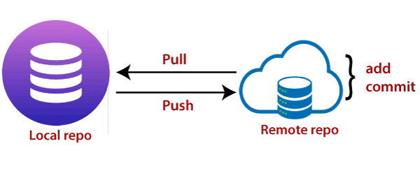
Git for Windows
git push
The push term refers to upload local repository content to a remote repository.
for example:
$ git push origin master

Slide 17
Git for Windows
git pull
The term pull is used to receive data from GitHub. The git pull command is used to pull a repository.
Syntax:
git pull origin master
There is another way to pull the repository. We can pull the repository by using the git pull command.

Slide 18
Branching and Merging
Step 1 : Create branch
git branch “branch name”
Step 2 : Checkout branch
git checkout “branch name”
Step 3 : Merge new branch in master branch
git merge “branch name”
Step 4 : Delete branch
git branch -d “branch name”

Slide 19
Tags
Create tag with some name
git tag "tag name"
example : git tag v1
Display or Show tags
git show v1

Slide 20
Tags
Push tags to remote
git push origin v1
Delete tags
git tag -d v1
git tag --delete v1

Slide 21
THANK YOU

